Slide 1
Disease Detection using Blood Smear Analysis by Quantification of WBC/RBC
ASHLEY ANTONY (101504)
MRINALI SONAWANE (101558)
PRAJAKTA WANI (101564)
DEEPSHIKHA ZUTSHI (101565)

Slide 2
ABSTRACT
Blood smear analysis is an important diagnostic test which is performed to diagnose an array of diseases. The count of various blood cells and their morphological properties are the main focus of this test. Manual analysis of blood smears is time consuming and laborious. By automating this process and ultimately narrowing the scope of possible diseases, a considerable amount of time can be saved. This may in turn help medical staff as well as the patients. In this project an automated technique for blood smear analysis using image processing is proposed to discern the blood cell count and blood cell properties. The results of image processing are then employed to generate a neuro-fuzzy system capable of predicting possible diseases.

Slide 3
Existing System
The existing manual system for pathological detection of blood cell count involves both physicians and computer scientists. The blood smear sample is analysed under the conventional light microscope.
The simplest test is blood cell count and differential.

Slide 4
Challenges Faced
Tedious procedure
Error prone
Time-consuming

Slide 5
LITERATURE SURVEY
In the first paper,Disease Detection using Blood Smear Analysis by Pragati Sharma based on Image processing and neuro fuzzy system, it achieves the objective using Gray scale conversion, Noise removal(Complement image and fill holes), Image conversion to binary, Get count by removing rbc and platelets.
In the paper on Robust Segmentation and Measurements Techniques of White Cells in Blood Microscope Images using Robust Segmentation and Image Processing, the algorithm includes the following steps:
Preprocessing the image in order to reduce acquisition noise and background non-uniformities
To estimate the average cell diameter
To perform segmentation with different techniques and combine the results in order to exploit all the available a-priori information achieving a robust identification of white cells.

Slide 6
In ‘A Framework for White Blood Cell Segmentation in Microscopic Blood Images using Digital Image Processing’, the technologies used are Segmentation, Snake Algorithm, Zack thresholding, Canny edge detection and the steps involved in the algorithm are:
1.The color scale image of microscope blood image
2.Convert to gray level image.
3.Sub image separation of wbc.
4.Edge detection.
5.Finding nuclei using GVF Snake.
6.Hole filling
7.Segmented nucleus.
8.Subtract nucleus from grayscale image
9.Finding cytoplasm using Zack thresholding.
10.Segment cytoplasm.

Slide 7
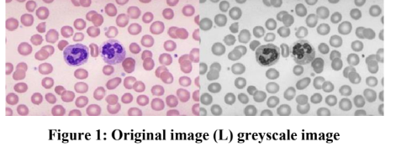
Disease detection using blood smear analysis
METHODOLOGY:
Image preprocessing:
Grayscale conversion:
Binary images used for image processing.
Uses MATLAB methods.

Slide 8
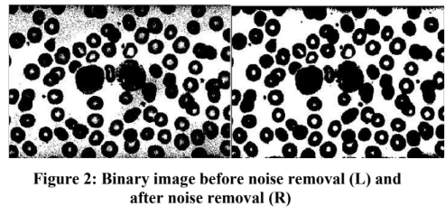
2. Noise Removal and image conversion to binary
Images are prone to variety of noises
Used to remove pixels which don’t reflect the true intensities of the image.
Image conversion to binary - a pixel is of interest or not.
3.Counting of cells.

Slide 9
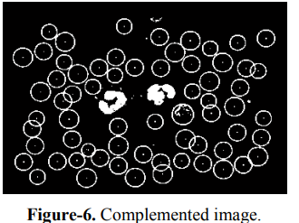
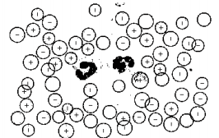
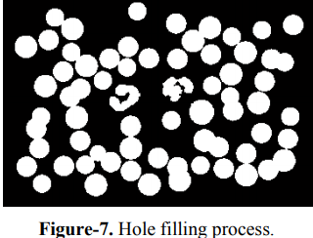
Image obtained after fuzzy logic:

Slide 10
Proposed system
Reading the image in Matlab and using image processing toolbox, converting image to grayscale.
Detecting edge using canny edge detection algorithm.
Delinating image border using dilate in Matlab
Noise removal is done to remove extra edges present outside cell boundaries using imcleanborder.
Hole filling is done to differentiate between cells and its boundaries and cell count is taken.
Overlapping count is also found separately

Slide 11
Software and Hardware Requirements
Software: Hardware:
1.OpenCV 4 GB RAM
2.MATLAB R2018b 1 TB HDD
3.Blood Smear Sample Dataset from Kaggle Intel i3 Processor
4.TensorFLow r1.12/Keras 2.2.0

Slide 12
Convolutional Neural Networks
-->In machine learning, a convolutional neural network (CNN, or ConvNet) is a class of deep, feed-forward artificial neural networks, most commonly applied to analyzing visual imagery. -->CNNs use a variation of multilayer perceptrons designed to require minimal preprocessing. They are also known as shift invariant or space invariant artificial neural networks (SIANN), based on their shared-weights architecture and translation invariance characteristics. -->Convolutional networks were inspired by biological processes in that the connectivity pattern between neurons resembles the organization of the animal visual cortex. -->CNNs use relatively little pre-processing compared to other image classification algorithms. This means that the network learns the filters that in traditional algorithms were hand-engineered. This independence from prior knowledge and human effort in feature design is a major advantage.

Slide 13
Steps in Convolutional Neural Networks
We start off with an input image.
We apply filters or feature maps to the image, which gives us a convolutional layer.
We then break up the linearity of that image using the rectifier function.
The image becomes ready for the pooling step, the purpose of which is providing our convolutional neural network with the faculty of “spatial invariance”.
After we're done with pooling, we end up with a pooled feature map.
We then flatten our pooled feature map before inserting into an artificial neural network.

Slide 14
Modules
The project is divided into following four modules.They are:
1) Input and preprocessing module
2) Segmentation module
3) Classification module
4) Disease detection module

Slide 15
IMPLEMENTATION

Slide 16
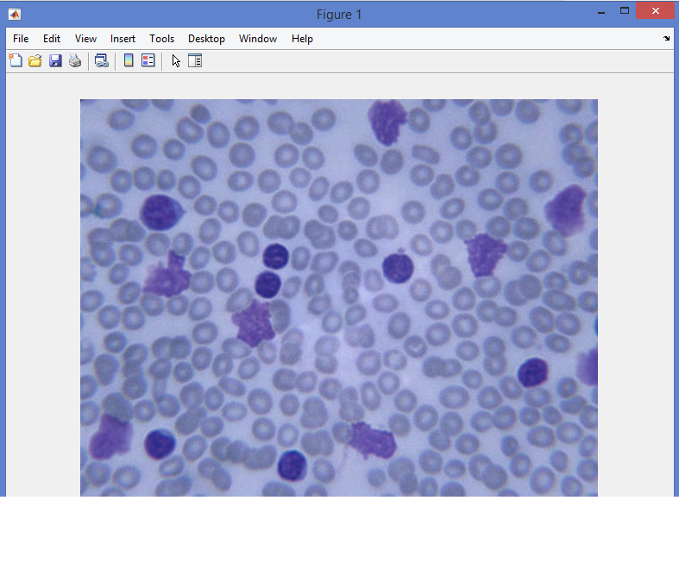
neI.

Slide 17
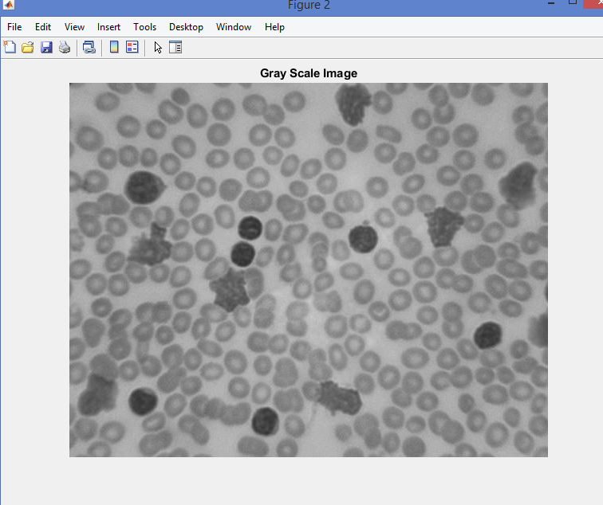
II.

Slide 18
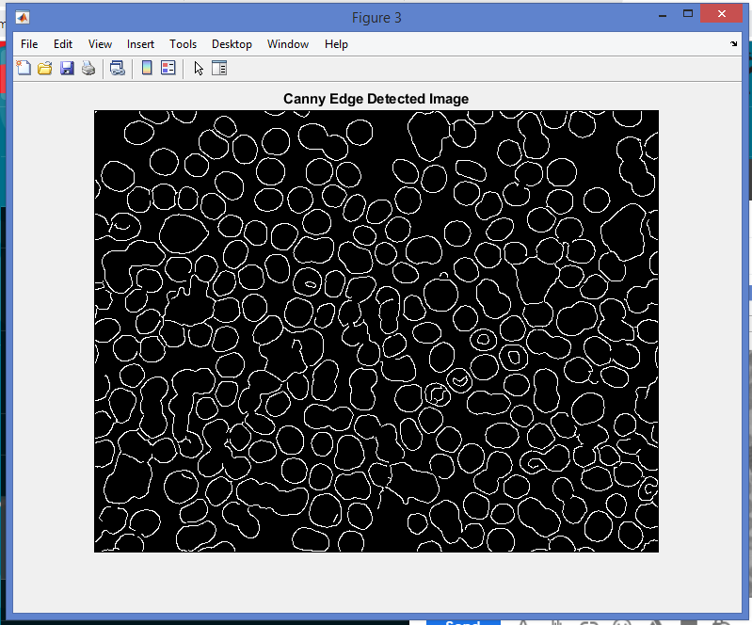
III.

Slide 19
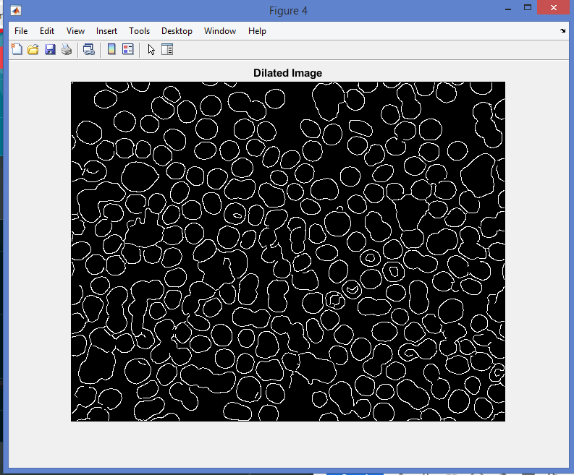
IV.

Slide 20
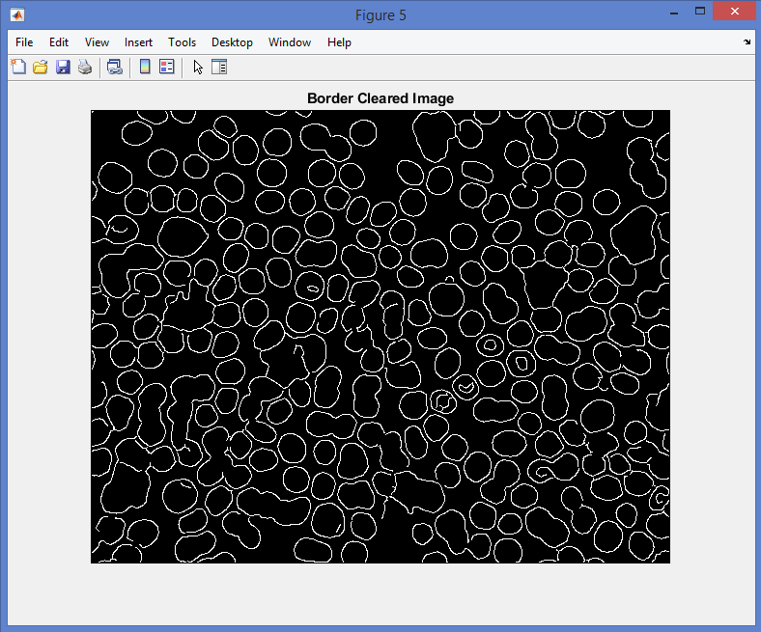
V.

Slide 21
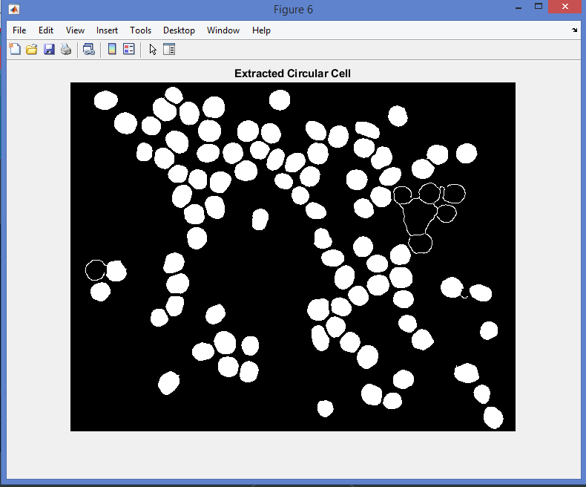
VI.

Slide 22
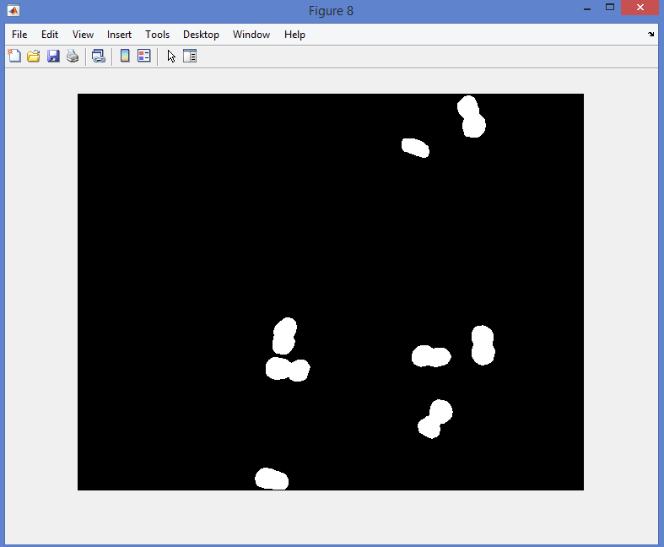
VII.

Slide 23
Conclusion
With the implementation of proposed method, we will get the results which calculates the minimum number of pixels detected because there can be huge no. of RBCs, fluid and WBCs and the percentage of RBCs & fluid in the complete cell would be more than the WBCs in the image. So, when calculating the diseased area, it would be the minimum of the overall area covered by colored pixels. The proposed method can be very helpful in diagnosing diseases like the blood cancer at early stage. So, here we conclude the results achieved:
1. Number of cells counted manually are same in some of the case because the images are clear and the cells are prominent in size to be captured by human eye.
2.The wbc which cannot be detected by human eye would be detected.

Slide 24
THANK YOU!

